Slide 1

Search in the Era of Large Language Models
Carolina Gonçalves, Champalimaud Foundation

Slide 2





What do I mean by search?
The process of finding and retrieving relevant information with respect to a specific need or question.
Search
Retrieve

Slide 3

Problem
Exponential growth of knowledge.
Publication rate has surpassed our ability to process and memorize information.
Significant advances could be missed.
It will become increasingly more difficult to use past knowledge and extract logical conclusions from other people’s work.
Progress will slow down.
Notes:
There’s an exponential growth of knowledge, with new books, papers, articles being published or updated every day.
It has become impossible for us humans to read, organize and memorize all this information.
Without an efficient way to help us deal with all this information, significant achievements might be missed and it would become increasingly harder to do our jobs, without easy access to these information sources.
Why is this important?
Invention of the printing press, to the scientific revolution (enlightenment) and the industrial revolution brought a mass production of knowledge and information in the form of books, papers, articles,...
Later, with the digitalization and internet the accumulation of knowledge got even more overwhelming.
This is knowledge that evolves and endures through the human race lifespan rather than that of an individual, allowing for significant benefits and advancements in science, technology, education, medicine,,... improving our quality of life and leverage life expectancy.
The corpus of human knowledge has become too large and too complex for us to directly access and read everything.
So, without an efficient method to fully organize and find information, …
So, we need something to aid us in organizing and accessing all this information. Something that augments our memory: gives use the privilege of forgetting, because we know we can find that information easily if we need to.

Slide 4
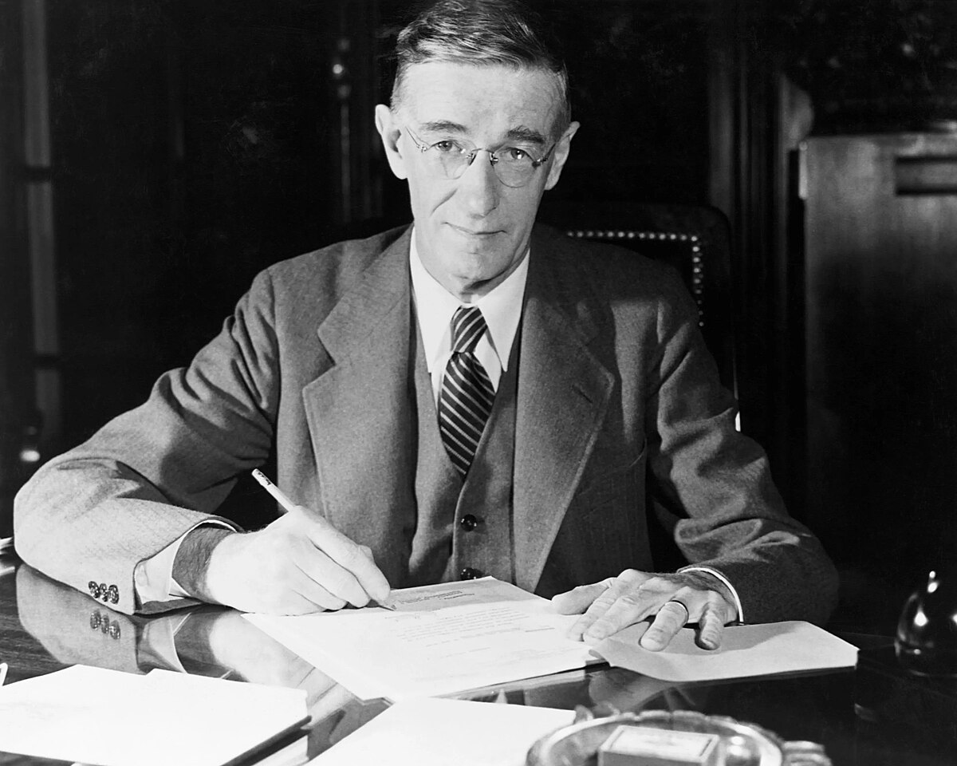
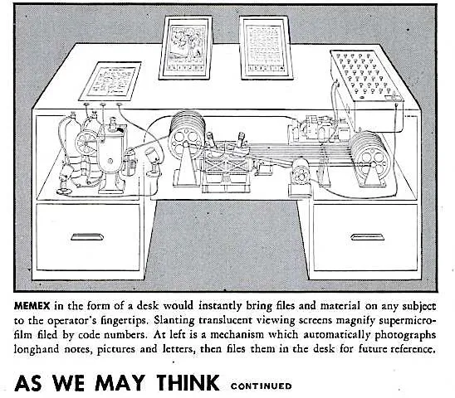
The beginning of an idea
“Consider a future device (...) in which an individual stores all his books, records, and communications, and which is mechanized so that it may be consulted with exceeding speed and flexibility. It is an enlarged intimate supplement to his memory.”
As We May Think, Vannevar Bush 1945
Notes:
Back in 1945 (even before internet, let alone computers were invented), there was already someone foreseeing the explosion of knowledge and the need to 'navigate' this ocean of knowledge in a logical way.
Vannevar Bush envisioned a device (called Memex) that would allow people to store, organize,and retrieve information. They could even right comments or notes and associate different documents with each other (akin ot the way wikipedia pages can be connected to other when mentioning similar concepts). This would give humans the privilege of (selective) forgetting: we could forget about information that we know where we can find with ease.
Although this device was never actually created, it was an important thought experiment that inspired many of the ideas in the current field of search, including Hypertext and World Wide Web, human-machine interaction, personalized search, information retrieval, among others…
He envisioned a personal information management system that would allow individuals to store, organize,and retrieve information with ease.
(It was imagined as a desk-like machine that used microfilm technology to store books, records, and communications.)
It has an interface for humans to interact with the machine, by searching through the stored information, making comments or notes and linking stored items (documents, articles,..) together.
He defended an associative memory, akin to the human brain memory, where pieces of information in storage would be associated to others based on shared ideas, topics,..., instead of just indexing them as numbers/locations in a human-curated list.
(the systems for indexing data are still insufficient and rely too much on linear pathways rather than the association-based system of the human brain)

Slide 5





Search engines
Notes:
A search engine is a software system designed to search for information on the internet. (It indexes web pages and other types of content,) It allows users to enter queries (typically in the form of keywords or phrases) and receive a list of results that are relevant to their search. These results usually include links to web pages, images, videos, news articles, and other types of content.
History of search engines: https://www.oslash.com/blog/history-evolution-of-web-search#the-first-crawler-bots-archie-veronica-and-jughead-1990-91

Slide 6

How to efficiently do
?
Notes:
Let’s try to imagine that we are software engineers and we need to build a search engine. Let’s assume that our system is already capable of collecting and organizing data from web pages, pdf documents, any other type of content.
And now, upon a query, the system need to find the relevant information in all this data. What methods could be use to implement this?

Slide 7





good recipe for apple crumble
“Recipe for baked apples with, with the best caramel and crumble topping”.
“Very easy to make, this apple crumble recipe is a keeper that you’ll make again and again.”
“I don’t really like apple crumble. Instead, I’ll give you a very good recipe for a cheesecake.”
“An apple a day is very good for your health.”
Notes:
Imagine that a user of your system wants to find a good recipe for apple crumble and it inputs this as a query: “good recipe for apple crumble”. What would she/he be expecting? And how could we obtain this from our data?
Should we just search the documents one by one to search for the recipes?
Keyword-search
And what if there’s a web page just talking about fruit, including apples, and naming all the dishes you can cook with these fruit, such as crumble. This would probably show up as a match, based on the keywords. Would this be a relevant result for this query?
It would be less relevant than others (ranking: attributing a score to each document and ordering them by relevance to the query)
We could also categorize the documents (already in the metadata or with AI - knowledge graphs) and the query as well. And then we’ll look for matches only inside that group/class
Identify maybe “apple crumble” as an entity: desert and search for them together
What about the word “good”. Is this also a relevant keyword? What is a good recipe anyway?
Use it as a different type of signal: tell the search engine to find documents with high popularity, good reviews,...

Slide 8
good recipe for apple crumble
“Recipe for baked apples with, with the best caramel and crumble topping”.
“Very easy to make, this apple crumble recipe is a keeper that you’ll make again and again.”
“I don’t really like apple crumble. Instead, I’ll give you a very good recipe for a cheesecake.”
“An apple a day is very good for your health.”

Slide 9
good recipe for apple crumble
“Recipe for baked apples with, with the best caramel and crumble topping”.
“Very easy to make, this apple crumble recipe is a keeper that you’ll make again and again.”
“I don’t really like apple crumble. Instead, I’ll give you a very good recipe for a cheesecake.”
“An apple a day is very good for your health.”

Slide 10



How do search engines work?
Web Crawler
Indexing
Fetch and process content from web pages.
Organize the gathered data like a catalog for fast retrieval.
Matching
Send Data
User queries
Ranking
Rank the data according to the relevance of the searched query
Querying
Results
Notes:
They work by crawling and indexing billions of web pages, and then using complex algorithms to match user queries with relevant web pages based on factors like keyword density and backlinks
ingest content (indexing), return content matching incoming queries (matching), and sort the returned content based on some measure of how well it matches the query (ranking).

Slide 11
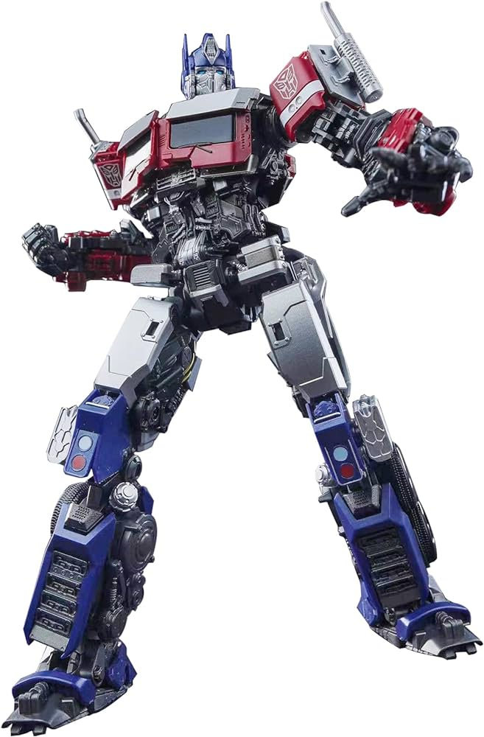





Keyword Search
What is a Transformer in Artificial Intelligence?
Preprocess text
What is a Transformer in Artificial Intelligence?
transform artifici intellig
Invert indexing and ranking algorithm
what | [0, 1, 2, 3, 4, 5]
transform* | [1, 3, 4, 6]
artifici* | [1, 6]
(...)
BM25
Rank documents based on keyword frequency.
Prioritizes multi-keyword matches.
Accounts for document length.
Weights less most common and general terms words.
* if you use stemming
Notes:
Let’s imagine someone enters this question as it is in your search engine. Do you see any problems that can arise from these?
Match documents based on irrelevant words.
Miss certain matches because of variations in words (plural, capital case, ...) (e.g: a document saying: “Transformers are deep learning models…”)
Now, with our pre-processed query, we can make our search based on the remaining keywords:
I didn’t say this before, but when our search engine gathers all the text from documents/web, it also indexes it. This means that it will attribute an ID to each document and organizes it in an efficient way to facilitate search. One of the most popular methods to do this is Invert Indexing (explain it).
This allows to identify the documents that have all our keywords (matches)
Then we can take our matches and rank them:, attribute a score to each these documents based on how much those keywords are present in the document and of their all present, instead of just one. And then order them.
One famous algorithm used for this is BM25.
This is a common implementation of keyword search and it’s very fast in searching and retrieving information.
Do you think this is good enough or do you think this can still fail?
There can be documents that, although having the keywords, might not be really answering the question.
Polysemy/ambiguity of keywords.
(go to the notebook in the hyperlink)

Slide 12


How to improve this?
Intent understanding
Context-aware search
Semantic meaning
…
“Search on things, not strings”
“A critical first step towards building the next generation of search is to understand the world a bit more like people do.”
Amit Singhal, Google Inc.

Slide 13
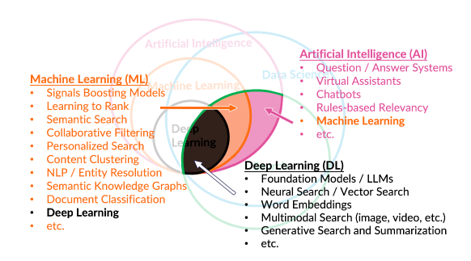
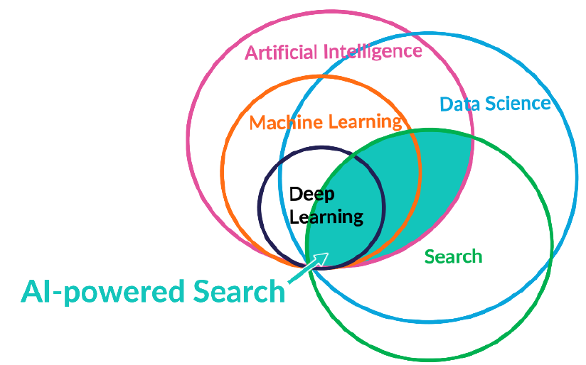
Search: Matching and Ranking
Query understanding and expansion:
Extract (multi-word) entities, expand with synonyms, related terms, correct misspellings,...
Learning to Rank:
Score features differently (title, date, reviews,...).
User interactions.
(...)
Taken from “AI-Powered Search”, Grainger at al.
Notes:
This is where AI starts to enter. We can leverage AI models to help finding matches and ranking them. This can be done by:
Leveraging language models to help the system interpret the query better
Identify multi-word entities in queries and documents
Expand the keywords with synonyms or related words.
Correct misspellings,...
Learn which other features of our data are also important, besides just keyword match, and how much should they matter in the final ranking scores.
These systems can also leverage user interactions (e.g: what are the searched queries or topics most commonly searched by users? When users searched for this query, what did they clink on or what did they buy?). All of this can be used to define what are relevant results that should be shown or to make recommendations of products, for example.
Signals boosting: for each query, aggregating all users’ clicks on each document and used the most clicked on as the most relevant.
Collaborative filtering: the common "users who liked this item also liked these items". Use patterns of user interaction with items to learn user preferences or the strength of relationship between items, and to then recommend similar items based upon those learned relationships.
They have a matrix of users-items interactions. Then, they use algorithms to perform matrix factorization to learn latent features about items based on user interactions (Latent features are features that are not directly observed but are inferred from other observed features).
Breaks it into two separate matrices - one mapping each user to a set of features, and one mapping each item to a set of features.
We don’t have names for these latent features or know exactly what they represent, but they are discovered mathematically and are nevertheless predictive of actual user- item interests. The idea is that: similar users interact with similar items precisely because the items share features that overlap with the user’s interest. In other words, a vector representing the users' interests should be similar to the vectors representing the items for which the user has expressed interest.
We end up with having one vector representation for each user and for each item. These can thereafter be used independently to predict the similarity between any user and item, between any two users or between any two items by comparing the corresponding vectors.
We can also use these latent factors directly to cluster users or items together (or use embeddings of the text description as well…): form dynamic categories for personalised search, ensuring that users are not shown results that are personalized too far outside of their interests.
Cold start problem: combine this with content-based attributes/signals for ranking and/or using LTR w/ active learning. The latter leverages a probabilistic model to select promising set of features for exploration. Using a set of features, we can find what documents are missing in the LTR model’s training data (so, in the click models that are serving as ground-truth judgements), selecting those to show users and see how they interact. We can keep retraining the LTR model and experimenting with different ways of describing the data via features to find new and interesting blind spots and areas of investigation.
Normally, this is what cookies serve for. When we accept cookies, we are allowing these systems to identify us as a user (maybe by using out IP address) and track all our interactions to improve their search algorithm, which is good but it can also become bad if they abuse of this signals.

Slide 14





Generative AI
Now, we have LLMs…
Deep neural networks trained on billions of web text data.
These can interpret language and generally reason about most concepts.
Perform multiple tasks, such as classification, translation, summarization, question-answering and generation of new data based on incoming context.
“General-purpose task solver”.

Slide 15



Are LLMs our Memex?
Notes:
But is that all we need? Can we just use LLMs to search and retrieve information?
Why not?
These models will always depend on the training data and task.
They may lack recent information.
They might emphasize biases or errors in the data.
We don’t know the details of the training procedure or the dataset used in this pre-trained LLMs, so we lose control.
Pre-trained LLMs sometimes don’t perform that well for specific cases (e.g: upon a sentence or a document, cite the corresponding scientific papers; or answer legal questions).
For this, one can finetune an LLM. But it is still expensive and requires computational resources.
The model does not have reliable access/ability to recall factual knowledge. It has a lossy compression of information, which can lead to hallucinations or incorrect answers.
Why not?
LLMs (and other foundation models) serve as reasoning engines, having enough knowledge of the world to interpret language and generally reason about most concepts, but without the ability to reliably recall factual information without the risk of hallucinating (making up false information). (page 22)
Lossy compressions of information
Black-box: the results may be correct or impressive, but they are not easy to debug or correct when the model makes an incorrect judgment
We lose control
Always depend on the training (data): but one can finetune it for a more specific data or task, although it’s more expensive and it loses the generalization capabilities
May not have up-to-date information
Complexity and scalability

Slide 16
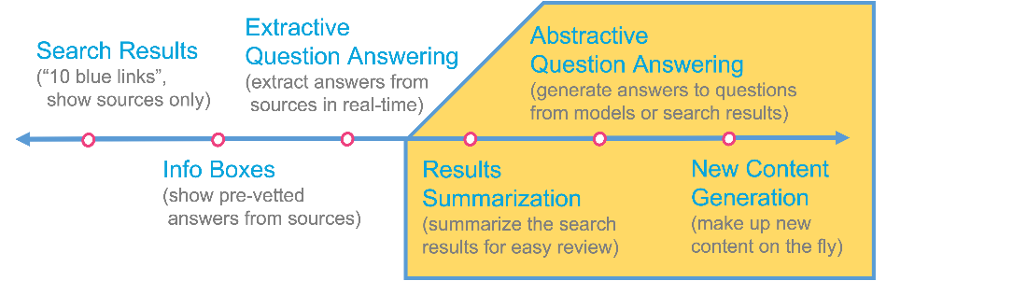
LLMs to improve search engines
Semantic search
Help guiding the search: query understanding, suggest queries,...
Generate summaries of search results.
Generate answers to questions directly from search results.
Transition from traditional retrieval to generative search
(taken from “AI-Powered Search”, Grainger at al.).
Notes:
LLMs can help search engines, by understanding the query, suggesting other queries or synonyms and by reading and processing the search results (documents) into a summary or an answer, for example.
We can also leverage LLMs for finding the relevant search results: this is what we call semantic search.
I’ll show you a quick example of this, but the idea is that: these models are trained such that they can understand text in general. And because of this training process, they learn to represent input words or tokens in al way that relates to their meanings and context in that specific input text. These representations are in the form of numerical vectors and are called embeddings.
Now, I’m not going to get into details here, just now that we can then leverage these embeddings to represent sentences, chunks of text and even documents.
Notebook:
So, we can compute the embedding for our query and for each of our documents (which are sentences in the notebook).
Then, we can measure how similar each document embedding is to the query embedding and order them by descending order of similarity.
The highest this score, the more similar the meanings of the sentence and the query should be.

Slide 17

Keyword search vs Embeddings
Fast and efficient.
Good if you must ensure certain keywords appear in the search results.
Does not understand the query.
More expensive.
Provide a better representation of the query as one unit of meaning.
Model context and semantic meaning.
Ability to handle more complex queries.
Hybrid methods

Slide 18
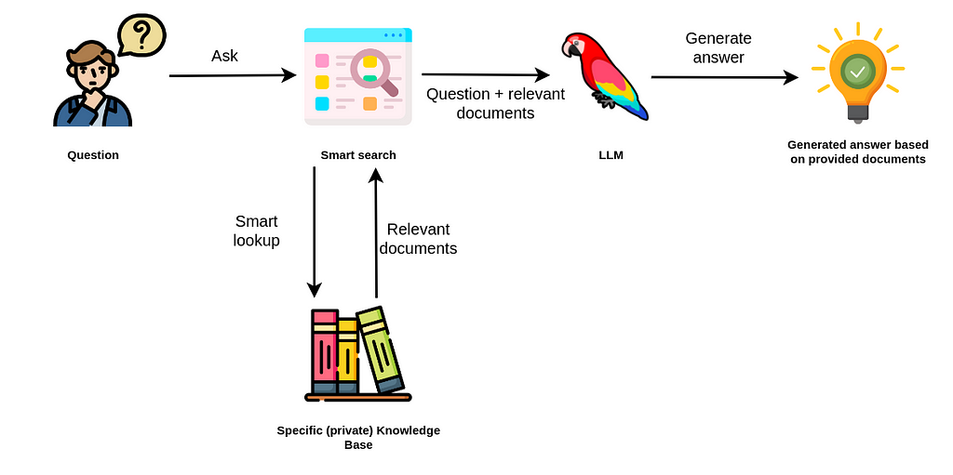
LLMs also need search
Retrieval Augmented Generation (RAG)
Notes:
And we can also have it the other way around: search engines helping LLMs, by selecting and retrieving the right information to give an LLM. (How to give the right context to an LLM?)
This can ensure the model has up-to-date and accurate data from which to answer and it can mitigate hallucinations
Same schema as in the first slide, but now we have an LLM processing the search results and returning an answer based on these results, but also on what is asked in the query (summarize, extract answer,...)

Slide 19

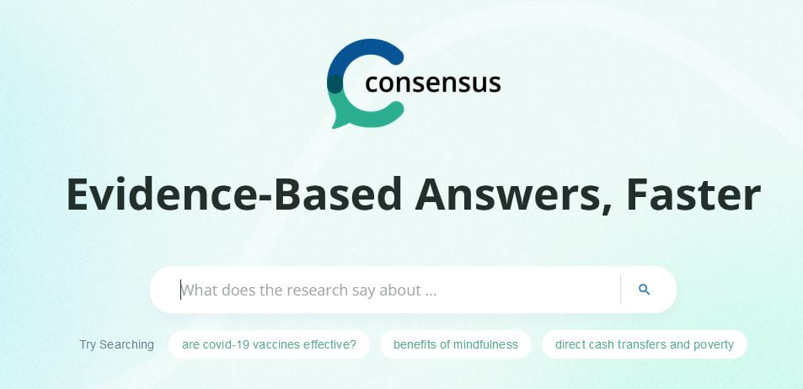
Search-answer engines
AI-powered answer or conversational search
Notes:
LLMs have been changing the search landscape, going beyond the traditional keyword matching and 10-blue links as a result, now we can have search engines in the form of chatbots. We can just have conversation with these models, aks questions and have them retrieve from the internet the relevant information and giving it to us in the form of a concise answer.

Slide 20
Traditional vs AI-Powered Search engines
Aspect | Traditional Search Engines | AI Search Engines
Query Understanding | Rely on keyword matching and basic natural language processing | Use advanced NLP models to understand the intent and context behind natural language queries
Result Presentation | Provide a ranked list of relevant web pages for the user to navigate and extract information from | Can generate direct answers, summaries, and engage in conversational exchanges to provide information
Personalization | Offer some personalization based on factors like location and search history | Provide highly personalized results tailored to user preferences, interests, and context
Continuous Learning | Rely on predefined algorithms and ranking factors that are updated periodically | Continuously learn and adapt their models based on user interactions and feedback to improve results over time
Multimodal Search | Primarily support text-based queries, with some voice search capabilities | Can handle multimodal inputs like voice queries, images, and potentially gestures or other interactive modes
Taken from Perplexity AI.

Slide 21


Challenges for LLM-Powered Search
Lack of transparency and control.
Dependency on the quality of the training data.
Prone to biases in the training data.
Computational complexity and scalability.
Hallucinations.
Ethical and trust issues with content generation.
…
Human-in-the-loop.
Hybrid search systems.
Notes:
These models have indeed revolutionized the way we perform search and AI-powered search is rapidly evolving because of it. Nonetheless, it’s important to remember that every new technology introduces new challenges and concerns to be addressed. Because of this, more successful future search systems will be the ones that combine multiple techniques that complement each other. And also systems that include the user in the process, because this not about just automating search or replacing anyone, this is about knowledge access and empowering humans to discover new knowledge and feeding their curiosity.
AI-powered search is rapidly evolving with the rise of Large Language Models, dense vector search, multimodal search, conversational and contextual search, generative search, and emerging hybrid search approaches.
There are many techniques for implementing AI-powered search, and the best systems in the future will be those that can effectively apply multiple relevant approaches together in hybrid search systems.

Slide 22

Questions?

